Slide 1

Bank Account System
Chen Ziying
Ju Zhijia
Notes:
Hi, we are team 14. I am Ziying and my team member is Zhijia. Our project is bank account system simulation.

Slide 2

Introduction
Our project performs the essential functions of banking software.
Create a new account
Make deposits and withdrawals
Exchange money
View the account’s records
Sub-Package 1: Structure
Establish account objects and define functions for account value
Sub-Package 2: UI and Data Storage
Design the interface for user and data storage for the bank
Notes:
The functions of our project are: copen account, make transactions such as deposit, withdraw and exchange money. And generate the statement for the account.
There are two sub-packages in our project: The first one is the base structure which is used to create object types and the function needed for account value calculation The other one is for user.

Slide 3

Sub-Package 1 Module 1 — Establishing Objects
Define class User for bank account user
Define subclass newUser inherits User
Define subclass eUser inherits User
User
newUser
eUser
for existing user
for new user

Slide 4


Functions
Brief description of three functions
Deposit: Deposit money to increase the account balance
Withdraw: Withdraw money to decrease the account balance
Information: Display all information of the account
Deposit
Withdraw
?
User
Account

Slide 5



Sub-Package 1 Module 2 — Define Functions for Account Value Calculation
Get interest rate and exchange rate online
Create functions for calculating account balance

Slide 6

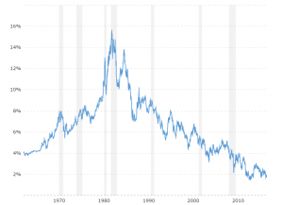



Functions
Brief description of three functions
Function 1: Get interest rates, exchange rate online
Function 2: Accrued Interest to the account
Function 3: Apply service fee for each transaction

Slide 7


Sub-Package 2 Module 1 — Design user interface
Create a friendly interface for user

Slide 8


Functions
Welcome to **Bank!
Function 1: Define labels for UI
(e.g. Welcome to **Bank!)
Function 2: Define the input box ()
(e.g. name, account number,…)
Function 3: Define buttons for UI ()
(e.g. submit)
name
account
amount
submit

Slide 9
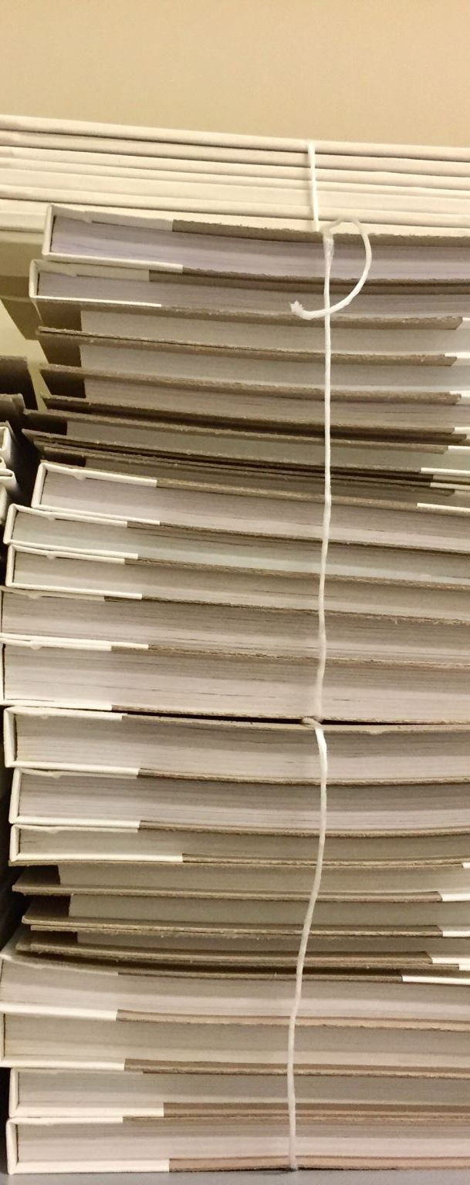


Sub-Package 2 Module 2 — Data Storage
Record Account Information
(e.g. name, account number)
Record Transactions
(e.g. date, amount, action,..)

Slide 10




Functions
Function 1: Add a new account/ transaction
Function 2: Read (e.g. for validation)
Function 3: Delete an existing account

Slide 11


